Slide 1

Academic Session 2025-26
ODD Semester Jul-Dec 2025
UNIVERSITY INSTITUTE OF COMPUTING
MASTER OF COMPUTER APPLICATIONS
DESIGN AND ANALYSIS OF ALGORITHMS
25 CAT 611
Unit No. 3 Chapter No. 3.2.7
Topic : Graph Colouring Using Backtracking
Faculty Name and E_Code Dr. Sameera(17674) Designation: Asst. Professor

Slide 2
Graph Colouring Using Backtracking
Graph Coloring Algorithm-
There exists no efficient algorithm for coloring a graph with minimum number of colors.
Graph Coloring is a NP complete problem.
However, a following greedy algorithm is known for finding the chromatic number of any given graph.
Greedy Algorithm-
Step-01:
Color first vertex with the first color.

Slide 3
Graph Colouring Using Backtracking
Step-02:
Now, consider the remaining (V-1) vertices one by one and do the following-
Color the currently picked vertex with the lowest numbered color if it has not been used to color any of its adjacent vertices.
If it has been used, then choose the next least numbered color.
If all the previously used colors have been used, then assign a new color to the currently picked vertex.

Slide 4
Drawbacks of Greedy Algorithm-
There are following drawbacks of the above Greedy Algorithm-
The above algorithm does not always use minimum number of colors.
The number of colors used sometimes depend on the order in which the vertices are processed.

Slide 5
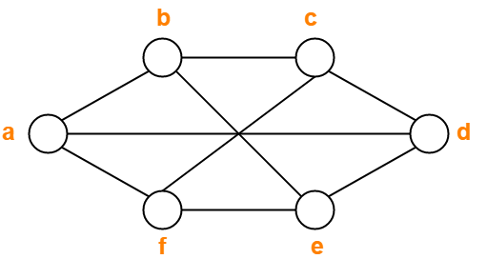
PRACTICE PROBLEMS BASED ON FINDING CHROMATIC NUMBER OF A GRAPH-
Problem-01:
Find chromatic number of the following graph-

Slide 6
Solution
Solution-
Applying Greedy Algorithm, we have-
Vertex | a | b | c | d | e | f
Color | C1 | C2 | C1 | C2 | C1 | C2
From here,
Minimum number of colors used to color the given graph are 2.
Therefore, Chromatic Number of the given graph = 2.

Slide 7
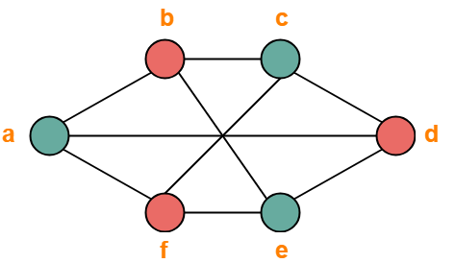
Solution
The given graph may be properly colored using 2 colors as shown below-

Slide 8
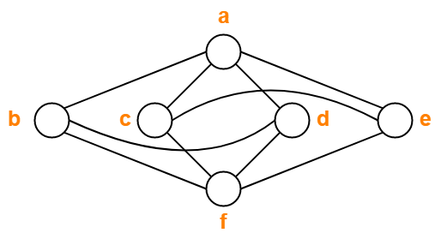
Problem-2
Find chromatic number of the following graph-
Solution-
Applying Greedy Algorithm, we have-
Vertex | a | b | c | d | e | f
Color | C1 | C2 | C2 | C3 | C3 | C1

Slide 9
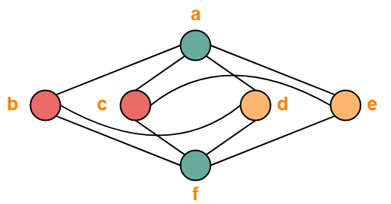
Solution
From here,
Minimum number of colors used to color the given graph are 3.
Therefore, Chromatic Number of the given graph = 3.
The given graph may be properly colored using 3 colors as shown below-

Slide 10
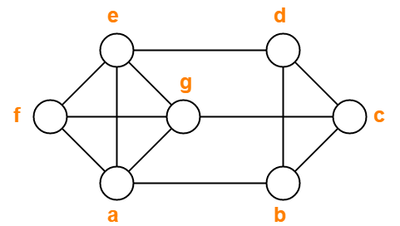
Problem-03:
Find chromatic number of the following graph-
Solution-
Applying Greedy Algorithm, we have-
Vertex | a | b | c | d | e | f | g
Color | C1 | C2 | C1 | C3 | C2 | C3 | C4

Slide 11
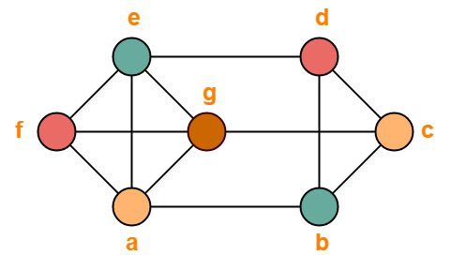
Solution
From here,
Minimum number of colors used to color the given graph are 4.
Therefore, Chromatic Number of the given graph = 4.
The given graph may be properly colored using 4 colors as shown below-

Slide 12
1) https://www.tutorialspoint.com/data_structures_algorithms/divide_and_conquer.htm
2) Data Structures and Algorithms made easy By Narasimha Karumanchi.
3) The Algorithm Design Manual, 2nd Edition by Steven S Skiena
4) Fundamentals of Computer Algorithms - Horowitz and Sahani
References

Slide 13
THANK YOU

